Slide 1
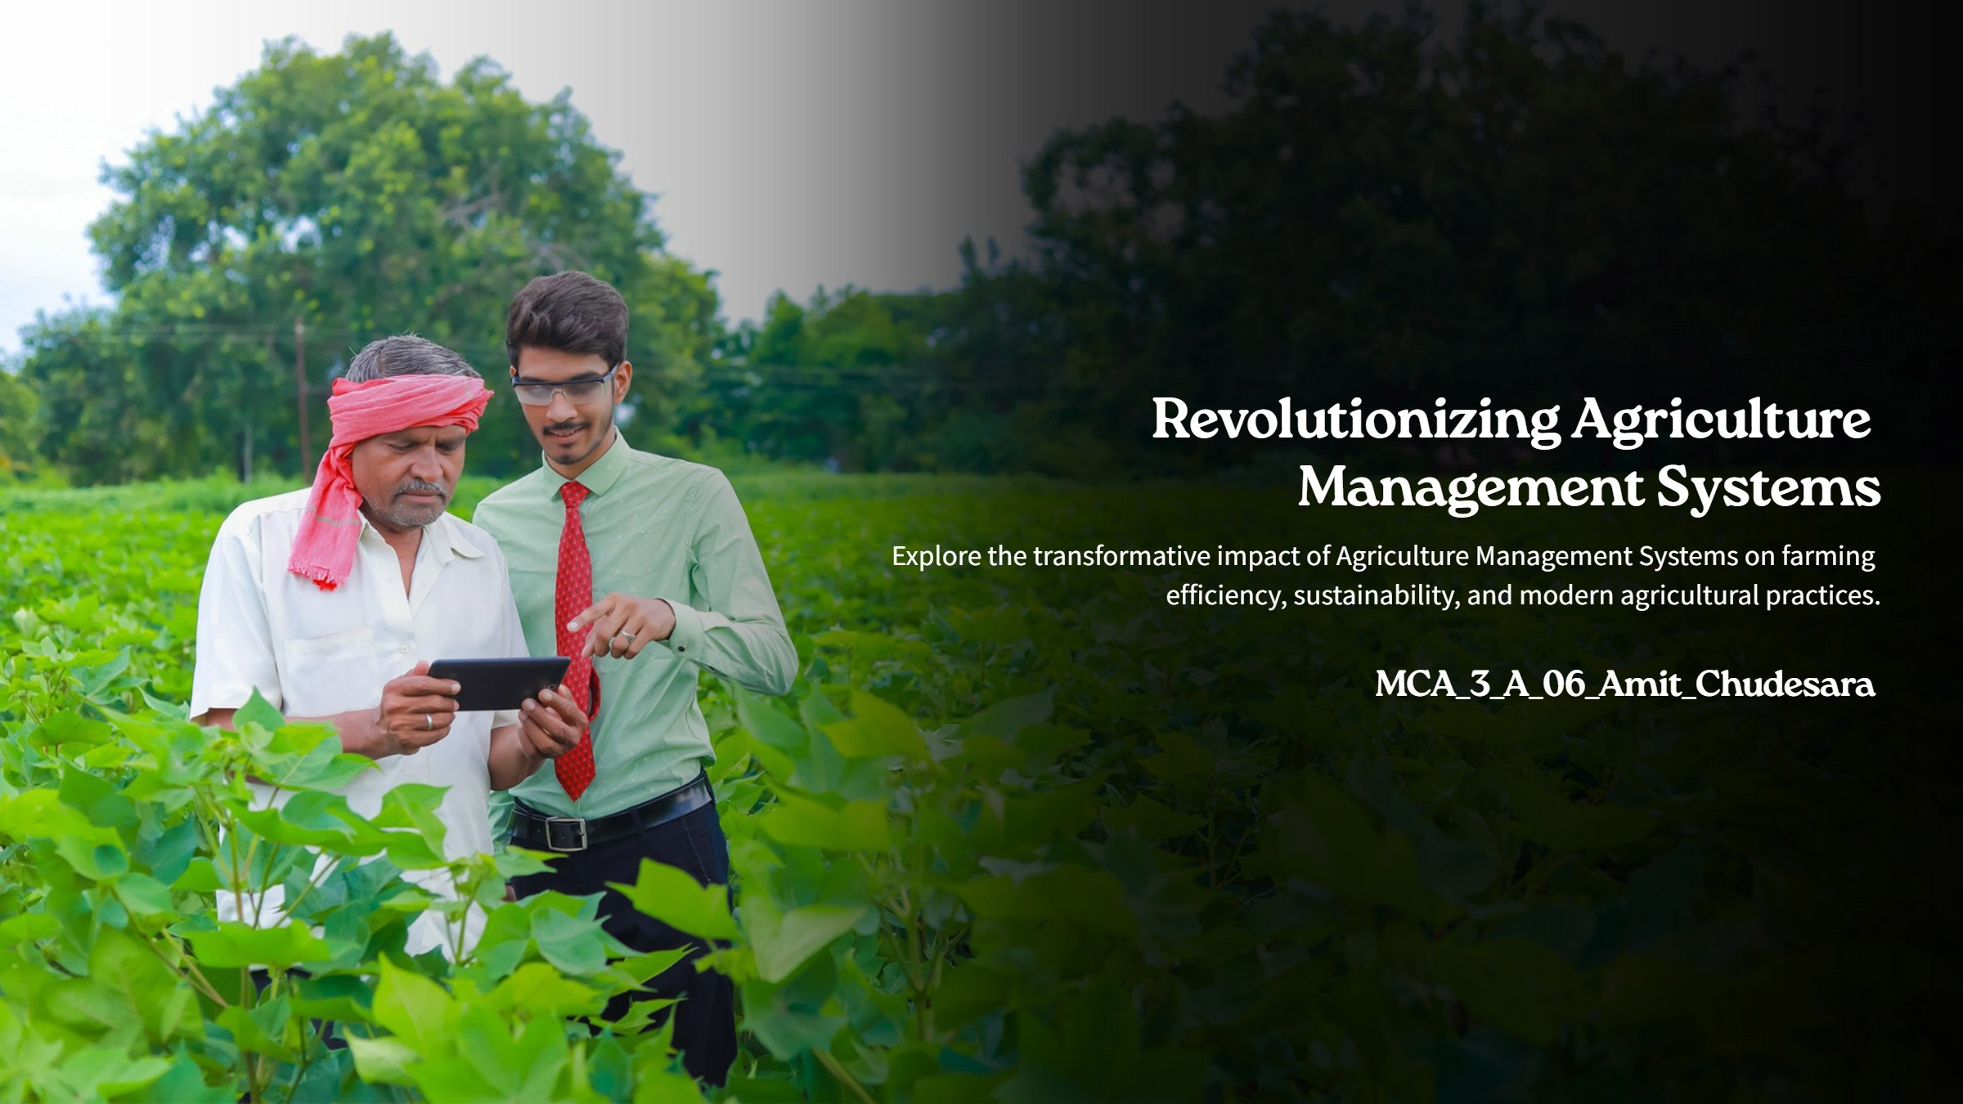








Agriculture management system
TECHZA
Online Learning management System
Project Devloped By:-
A06-Chudesara Amit (23004401110043)
A18-Khavadiya Ankit(23004401110119)
A46-Saiyed Simun(23004401110263)
Project Devloped By:-
A06-Chudesara Amit (23004401110043)
A18-Khavadiya Ankit(23004401110119)
A46-Saiyed Simun(23004401110263)
Guided By:-
Dr. Bhavin Shah
Guided By:-
Mr. Ashutosh Sadaria

Slide 2
1.1Existing System:
In the current scenario, most agricultural activities are managed using traditional, manual methods. Farmers and agricultural businesses rely heavily on paper-based records, which are prone to damage, loss, and human error. Operations such as crop management, inventory tracking, irrigation scheduling, and financial record-keeping often lack centralization and proper documentation. This leads to inefficiencies, mismanagement of resources, and challenges in monitoring overall productivity.
Additionally, the absence of a digital system makes it difficult to integrate real-time weather updates, market prices, and crop yield predictions into decision-making. Farmers often face challenges in accessing data or making informed decisions based on trends, as the existing systems do not support automated analysis or reporting. Communication between different stakeholders, such as suppliers, distributors, and labourers, is fragmented, leading to delays and reduced operational efficiency.

Slide 3
Another significant drawback of the existing system is its inability to provide secure data storage. Important records related to crop cycles, expenses, and sales are often scattered, making it harder to retrieve and analyse historical data. The lack of integration with modern tools and technologies also makes the existing system ill-suited to adapt to the growing needs of precision farming and sustainability.
The limitations of the current system highlight the need for a robust, centralized, and automated platform to address these inefficiencies. The proposed Agriculture Management System aims to fill this gap by digitizing and streamlining agricultural processes, ensuring better resource utilization, and enhancing productivity for farmers and businesses.
Moreover, the inability to provide real-time collaboration among various stakeholders adds another layer of inefficiency. For instance, delays in communication between farmers and suppliers can result in late deliveries of essential inputs, while poor coordination with distributors can lead to missed market opportunities. These gaps in communication and collaboration hinder the overall growth and profitability of agricultural businesses.

Slide 4
1.2 Needs of new system
Centralized Data Management
Improved Resource Allocation
Enhanced Productivity
Real-Time Monitoring
Automation of Repetitive Tasks
Accessibility and Convenience
Cost-Effective Operations
Scalable for Future Needs

Slide 5
1.3 Objectives of the new system:
Centralized Data Management.
Automation of Processes.
Improved Decision-Making
Resource Optimization
User Role Management
Scalability and Flexibility
Cost Efficiency
Secure Data Storage
Ease of Use
Real-Time Monitoring

Slide 6
1.4 Problem Definition
This system aims to provide tools for monitoring weather, soil conditions, and inventory while optimizing decision-making and promoting sustainability. It ensures better productivity, profitability, and environmental stewardship in the agricultural sector.

Slide 7
1.3 Core Component
1. User Management
Description: The user management component allows different users to access the system based on their roles (Admin, Farmer, vendor, etc.).
Functionality:
Registration: Users can create their accounts with a secure authentication system.
Login/Logout: Users can log in and out with unique credentials.
Role-based Access Control: Depending on the user role, different permissions
and access levels are assigned (e.g., an admin can manage users, but a farmer can only manage crops).
Profile Management: Users can update personal information, change passwords, and manage preferences.

Slide 8
2. Crop Management
Description: This component enables farmers to manage their crops, from planting to harvesting.
Functionality:
Crop Details: Add, update, and delete crop details, such as type, variety, planting date, etc.
Growth Monitoring: Track crop progress with data entry on the various growth stages and conditions.
Harvesting and Yield Tracking: Record the yield and harvest details for analysis.
Crop Rotation: Schedule and monitor crop rotation to improve soil health and productivity.
3.Irrigation Management
Description: This component allows the system to schedule and track irrigation needs for the crops.
Functionality:
Irrigation Scheduling: Automatically schedule irrigation based on crop type, weather conditions, and soil moisture levels.
Water Usage Tracking: Monitor and record water usage to optimize irrigation and reduce waste.
Alerts: Notify farmers of irrigation needs or system malfunctions.

Slide 9
4. Inventory Management
Description: This component manages agricultural products, tools, and resources.
Functionality:
Product Tracking: Keep track of inventory items like seeds, fertilizers, pesticides, and tools.
Stock Level Monitoring: Alert users when stock levels reach a threshold and need replenishment.
Purchase/Usage Logs: Maintain records of purchased and used inventory, helping users monitor expenses and resource usage.
5. Weather Forecasting and Alerts
Description: Integration with weather APIs provides real-time updates on weather conditions, helping farmers plan activities.
Functionality:
Weather Data: Fetch real-time data for temperature, humidity, rainfall, etc.
Weather Alerts: Notify users about severe weather conditions like storms, frosts, or droughts.
Forecasts for Crops: Provide weather forecasts specific to crop types, advising farmers on optimal planting or harvesting times.

Slide 10
6. Financial Management
Description: This component assists farmers and managers in tracking the financial aspects of agricultural operations.
Functionality:
Expense Tracking: Record all expenses, including purchases of seeds, fertilizers, equipment, etc.
Income Tracking: Track revenue from sales of crops, livestock, or otherproducts.
Profit/Loss Analysis: Generate reports showing profit or loss, helping with budgeting and decision-making.
Tax and Legal Compliance: Maintain records for compliance with agricultural regulations, tax filings, and government subsidies
7.Reporting and Analytics
Description: This component provides various analytical tools and reports to improve farm management decisions.
Functionality:
Crop Reports: Generate detailed reports on crop performance, yield data, and harvesting patterns.
Financial Reports: Display graphs and tables summarizing income, expenses, and profitability.

Slide 11
8.Communication System
Description: Enables communication between different users and stakeholders within the system.
Functionality:
Messaging: Allows users to send and receive messages regarding crop performance, inventory needs, or alerts.
Notifications: Real-time notifications about important events, such as system updates, weather conditions, or crop-related activities.
Forum/Discussion Boards: Enable farmers and other users to discuss various topics, share experiences, and seek advice.
9.Database Management (MySQL)
Description: The backend database (MySQL) handles the storage and management of all system data.
Functionality:
Data Storage: All user data, crop, livestock, financial, and inventory details are securely stored in the database.
Query Optimization: Efficient SQL queries ensure fast data retrieval and reporting.
Backup and Security: Regular database backups are taken, and data security is maintained through encrypted storage and proper access controls.

Slide 12
10.Admin Dashboard
Description: The administrator panel is designed to manage the entire system, including user management, reports, and system settings.
Functionality:
User Management: Admins can add, update, or remove users and manage roles.
System Configuration: Admins can configure settings like irrigation schedules, financial rules, etc.
Data Monitoring: View real-time system activity, such as crop growth stages, livestock health, and inventory levels.
11. Mobile Responsiveness
Description: Ensures the system is accessible via mobile devices for easy monitoring and management on the go.
Functionality:
Mobile-Friendly Interface: The system interface adapts to smaller screens, making it usable on smartphones and tablets.

Slide 13
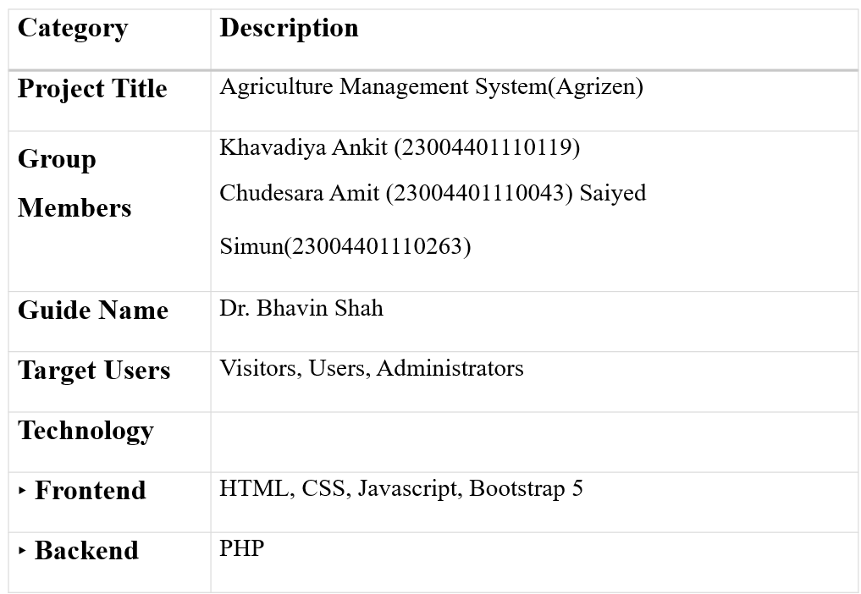
1.4 Project Profile

Slide 14
1.7 Assumptions and Constraints:
Assumptions:
Internet Availability:
The system assumes the availability of a stable internet connection to access the web application and synchronize real-time data.
User Familiarity:
Users, including farmers, managers, and administrators, are assumed to have basic computer literacy and can navigate a web-based application.
Basic Hardware Requirements:
It is assumed that users have access to a computer, tablet, or smartphone with a modern browser to access the system.
Data Entry Accuracy:
The system assumes that users will enter accurate and up-to-date information
regarding crops, livestock, financial data, and inventory. There is no automated data verification in place at the entry level.

Slide 15
Standardized Crop:
The system assumes a standardized format for crop types, livestock breeds, and other agricultural entities, to ensure consistency in data input and processing.
User Role Definition:
The project assumes a clear role-based user structure, with different levels of access for farmers, farm managers, and system administrators to ensure secure access control.
Support for Multiple Devices:
It is assumed that the system will be accessed on a variety of devices, with a responsive design that adjusts to different screen sizes.
8.System Scalability:
The application assumes it can scale to handle larger datasets as the farm oragricultural business grows, including more crops, livestock, and financial records.
Data Backup:
The project assumes that regular data backups will be implemented to avoid data loss due to system failures or unexpected shutdowns.

Slide 16
Constraints
Internet Dependency:
The system's performance and functionality are heavily dependent on an active
internet connection. In rural or remote areas where internet access is unreliable, the system may experience downtime or limited usability.
Limited User Expertise:
Farmers may have limited experience with technology, making the system’s user interface and features challenging for some users without proper training
or guidance.
Data Security:
While the system uses PHP and MySQL, there is an inherent risk of data security breaches. The project must address vulnerabilities such as SQL injections, unauthorized access, and weak passwords.
Device Compatibility:
While the system is intended to be mobile-responsive, there might still be compatibility issues with older devices or browsers, which could cause display or functionality problems.

Slide 17
5.Manual Data Entry:
o The system relies on manual data entry for many aspects (e.g., crop growth stages, livestock health, inventory updates). Errors in data entry could lead to inaccurate reports or decision-making.
Performance Limitations:
If the agricultural system expands beyond the original scope (e.g., multiple large farms with massive datasets), performance could be affected. Optimizing queries and database management will be a critical concern.
Customization Requirements:
The system may need customization to accommodate various local regulations, different farming practices, or specific features not part of the default package, which may require additional development resources.
Database Size:
The MySQL database is likely to grow rapidly with the accumulation of data. As the system scales, performance issues such as slow queries and data retrieval times may arise without proper database optimization.
Compliance with Regulations:
The system needs to comply with local agricultural and data protection laws. These regulations may vary from region to region, potentially limiting certain features or requiring additional legal checks.
Dependency on External Data Sources:
If the system uses external sources for data such as weather forecasts or market prices, the availability and accuracy of these data sources are outside the control of the project, and any disruptions could impact functionality

Slide 18
1.7 Advantage
Improved Efficiency:
Real-Time Data Access
Better Data Management
User-Friendly Interface
Cost-Effective:
Scalability:

Slide 19
1.7 Limitations:
1.Internet Dependency
2. Initial Setup Cost
3. Technical Knowledge Requirement
4. Data Security Risks
5. Hardware Limitations
6.Dependency on Software Updates

Slide 20
2 .Requirement Determination and Analysi
2.1 Requirement Determination
2.1.1Identify Stakeholders
Farmers:
Role: The primary users who will interact with the system to manage their agricultural activities. They need to be able to track farm operations like planting, harvesting, and input usage.
Key Responsibilities:
Manage farm details: Maintain farm location, size, crop types, soil type, and water sources.
Record and track farm activities: Log planting, irrigation, fertilization, pesticide application, and harvesting schedules.
Monitor crop performance and yield: Track crop growth, health, yield quantity, and quality.
Generate reports for activities and income: Create reports on farm operations, expenses, and profitability.

Slide 21
View and purchase from vendors: Browse vendor catalogs, compare products, place orders, and manage inventory.
Manage equipment and tools: Keep track of farm machinery, tools, and maintenance schedules.
Track weather conditions: Monitor weather forecasts and record climate impact on farming activities.
Budget and expense tracking: Maintain financial records of farm investments, operational costs, and sales revenue.
Soil and water management: Record soil test results, manage irrigation schedules, and ensure sustainable water use.
Monitor pest and disease control: Track pest infestations and apply appropriate treatments.
Participate in training and knowledge sharing: Access agricultural tips, best practices, and new technologies.
Collaborate with farm workers: Assign tasks, manage workforce schedules, and track labor productivity.
Apply for government subsidies and schemes: Submit applications for financial aid, subsidies, and farm
development programs.
Ensure regulatory compliance: Follow agricultural laws, food safety regulations, and environmental guidelines.
Manage multi-crop farming: Plan and rotate crops to maximize productivity and soil fertility.

Slide 22
Supplier:
Role: Suppliers providing essential farm goods like seeds, fertilizers, machinery, and tools.
Key Responsibilities:
Register and manage product catalogs: Add, update, and maintain details of seeds, fertilizers, machinery, and other farm-related products.
Respond to orders and provide timely delivery: Process farmer orders, ensure prompt shipment, and track delivery status.
Receive feedback and ratings from farmers: Monitor customer reviews, address complaints, and improve product quality.
Ensure product information is up-to-date and accurate: Regularly update product availability, pricing, and specifications.
Manage inventory levels: Track stock availability and prevent shortages or overstocking.
Offer discounts and promotions: Provide special deals or seasonal offers to attract more farmers.

Slide 23
Handle platform security and data privacy: Implement security measures, monitor potential threats, and protect user information.
Resolve user disputes and complaints: Address issues between farmers, vendors, and system users to maintain smooth operations.
Maintain system performance and uptime: Ensure the platform remains functional, responsive, and accessible to all users.
Approve and manage advertisements or promotions: Oversee sponsored listings, promotional content, and featured vendors.
Collaborate with developers for system improvements: Report bugs, request new features, and participate in platform upgrades.
Monitor financial transactions and payment gateways: Ensure proper processing of orders, payments, and refunds.
Collaborate with logistics partners: Work with transport services to ensure efficient product delivery.
Analyze sales trends: Track sales performance and adjust supply strategies accordingly.
Participate in training and awareness programs: Educate farmers about product usage, benefits, and best practices.

Slide 24
Administrators:
Role: System managers who oversee and ensure the smooth operation of the platform.
Key Responsibilities:
Approve, modify, or delete vendor registrations: Review vendor applications, verify details, and manage vendor access to the platform.
Manage users and roles: Assign, update, or revoke access for farmers, vendors, and other system users.
Generate system reports: Create reports on system performance, user activity, transaction logs, and compliance metrics.
Oversee farm and vendor activities: Monitor transactions, track farm activities, and ensure data accuracy.
Ensure compliance with system policies and regulations: Enforce platform guidelines and align operations with legal and agricultural standards.
Handle platform security and data privacy: Implement security measures, monitor potential threats, and protect user information.

Slide 25
Resolve user disputes and complaints: Address issues between farmers, vendors, and system users to maintain smooth operations.
Maintain system performance and uptime: Ensure the platform remains functional, responsive, and accessible to all users.
Approve and manage advertisements or promotions: Oversee sponsored listings, promotional content, and featured vendors.
Collaborate with developers for system improvements: Report bugs, request new features, and participate in platform upgrades.
Monitor financial transactions and payment gateways: Ensure proper processing of orders, payments, and refunds.
Provide support and training: Assist users in understanding system features and resolving operational issues.

Slide 26
2.1.2 .Gather Requirements
Interviews and Surveys:
Conduct detailed interviews with farmers, vendors, and admins to gather their requirements, understand pain points, and determine features that will improve the system.
Use surveys to capture broad user feedback on system features like usability, system reliability, and performance.
Existing System Review:
If there are any legacy systems currently in use, analyze their functionality to pinpoint their strengths and weaknesses. This will help identify areas for improvement or new features to integrate.
The goal is to build on the existing tools, possibly replacing outdated technologies with more modern alternatives.
User Stories:
Create user stories to map out how each user (farmer, vendor, admin) will interact with the system.
Example: "As a farmer, I want to record my harvests so I can track yield and quality over time."
These stories help break down functionality into manageable features and tasks.

Slide 27
Competitor Analysis:
Examine similar agriculture management systems available in the market. Review their features, technologies, and customer feedback to see what has worked well and what could be improved.
Example: Studying a competitor may reveal features like automatic weather updates for farmers or crop disease detection.
Regulatory Requirements:
Ensure compliance with agricultural laws and data privacy regulations (e.g., GDPR if applicable).
For example, there may be regulations on pesticide usage or government subsidies that the system must support.
The system must be aligned with local agricultural standards to avoid legal issues.

Slide 28
2.1.3.Categorize Requirements
2.1.1 Functional Requirements:
Farm Management:
Farm Registration: Allow farmers to register their farms with essential details such as location, size, crop types, etc.
Planting and Harvesting Schedules: Track planting dates and expected harvest times for accurate planning and record-keeping.
Input Tracking: Record and manage inputs like fertilizers, pesticides, and irrigation systems used on the farm.
Yield and Quality Tracking: Track the results of each harvest, including quantity and quality.
Vendor Management:
Vendor Registration: Vendors can create and manage their profiles, adding their products (seeds, fertilizers, tools, etc.).
Admin Approval: Administrators will have the ability to approve, edit, or delete vendor details based on compliance with system rules.

Slide 29
3.Reporting:
Farm Activity Reports: Generate daily/weekly/monthly reports on planting, harvesting, input usage, and farm expenses.
Financial Reports: Reports on farm profitability, cost analysis, and budgeting.
Yield and Expense Reports: Detailed reports to track crop yield, expenses, and overall farm financial health.
4.Inventory Management:
Stock Tracking: Track stock levels of essential supplies like seeds, fertilizers, and tools.
Order Management: Provide functionality for farmers to place orders directly with vendors for necessary farm supplies, managing stock levels and supplier responses.
5.User Management:
Registration and Access Control: Register farmers, vendors, and admins. Assign roles to ensure that each type of user has appropriate access and functionality.
Authentication and Authorization: Ensure proper user authentication (username/password, two-factor authentication, etc.) and define roles/permissions for different users.

Slide 30
2.1.2 Non-Functional Requirements:
Performance:
Multiple Concurrent Users: The system must support hundreds or thousands of users at once (farmers, vendors, admins) without crashing or slowing down.
Fast Report Generation: The system must be able to generate reports efficiently without significant delays, even as the data grows.
Usability:
Simple Interface: The UI should be intuitive and user-friendly, catering to users with varying levels of technical expertise.
Mobile Responsiveness: As farmers often work in the field, the system should have a mobile-responsive design to allow easy access via smartphones and tablets.

Slide 31
3.Scalability:
The system should scale as more farms, vendors, and users join the platform. This includes storage for additional data, ability to process more requests, and manage larger datasets.
4.Availability:
The system should offer high availability, ensuring that users can access the platform at any time (24/7), especially for emergency crop management or real-time supply orders.

Slide 32
2.4 Technical Requirements
Database:
MySQL: Use MySQL to store data on users, farms, vendors, products, and transactions.
Ensure a relational database structure to manage complex relationships (e.g., a farm has multiple crops, a vendor sells multiple products).
Backend:
PHP: Utilize PHP for server-side logic to handle user requests, interact with the MySQL database, and process farm-related operations.
MVC Architecture: Implement the Model-View-Controller (MVC) pattern to separate concerns (data management, user interface, and user input), promoting code reusability and maintainability.
Frontend:
HTML/CSS/JavaScript: Build a responsive and modern user interface using HTML, CSS, and JavaScript to ensure ease of navigation.
Libraries/Frameworks: Use Bootstrap for responsive design and jQuery for efficient DOM manipulation and AJAX requests.

Slide 33
4.Security:
User Authentication: Implement secure user authentication mechanisms, including password hashing, session management, and role-based access control (RBAC).
Data Encryption: Use encryption (e.g., SSL/TLS) to secure sensitive data, such as financial transactions, user personal data, and agricultural data.
SQL Injection Prevention: Use prepared statements in SQL queries to mitigate the risk of SQL injection attacks, ensuring the system is secure

Slide 34
2.2. Requirement Specification:
1. Farmers:
Farmers can register, manage their farms, and interact with the system to purchase supplies, track produce, and engage with vendors.
Registration and Profile Management:
Farmers can register an account with basic information (Name, Address , Email, Contact).
Profile management to update personal details, farm details, and contact information.
Manage Farm Details
Register and maintain detailed farm information, including location, size, crop types, and soil conditions.
Update details on available farmland, crop rotation schedules, and seasonal planting plans.
Document historical farm data to track changes and improvements over time.

Slide 35
Record and Track Farm Activities
Log daily farm operations such as land preparation, seed sowing, irrigation, fertilization, and pesticide application.
Maintain records of harvesting schedules, post-harvest storage, and distribution.
Track labor activities, including work hours, wages, and productivity.
Keep a timeline of farming cycles for better planning in future seasons.
Monitor Crop Performance and Yield
Regularly inspect crop health, growth patterns, and overall yield.
Document plant diseases, pest attacks, and other environmental impacts.
Compare actual vs. expected yields to optimize farm productivity.
Utilize analytics to determine the best crop varieties for specific soil and climate conditions.
Generate Reports for Activities and Income
Generate reports on farm operations, expenses, and revenue to assess profitability.
Track input costs such as seeds, fertilizers, pesticides, and labor expenses.
Maintain records of produce sales, revenue generation, and overall business performance.

Slide 36
View and Purchase from Vendors
Browse vendor product catalogs for seeds, fertilizers, pesticides, and farming equipment.
Compare prices, quality, and farmer reviews before making purchases.
Place orders for farm inputs and manage procurement schedules.
Track deliveries and maintain supplier relationships.
Manage Equipment and Tools
Maintain an inventory of farming tools, machinery, and equipment.
Track usage, efficiency, and maintenance schedules for farm machinery.
Schedule servicing for tractors, irrigation systems, and other essential tools.
Monitor fuel and energy consumption for sustainability.
Track Weather Conditions
Monitor real-time weather forecasts and alerts for potential risks like storms, droughts, or floods.
Maintain historical weather data to analyze seasonal trends.
Adjust farming strategies based on weather conditions to mitigate risks.
Set up automated notifications for extreme weather warnings.

Slide 37
Soil and Water Management
Conduct soil tests and record nutrient levels for improved crop selection.
Manage irrigation schedules to optimize water usage.
Implement water conservation techniques such as rainwater harvesting and drip irrigation.
Monitor soil erosion and take preventive measures to maintain land fertility.
Monitor Pest and Disease Control
Identify common pest infestations and implement preventive measures.
Record pesticide and fungicide applications and their effectiveness.
Use Integrated Pest Management (IPM) techniques to minimize chemical usage.
Track disease outbreaks and apply suitable treatment methods.
Participate in Training and Knowledge Sharing
Access online and offline agricultural training programs.
Stay updated on new farming techniques, sustainable practices, and technological advancements.
Engage in farmer networks, cooperatives, and forums to share knowledge.
Learn about the latest government policies and financial aid programs.

Slide 38
Collaborate with Farm Workers
Assign tasks to farm laborers and track their daily activities.
Manage payroll, attendance, and worker productivity records.
Ensure safety and labor regulations are followed.
Conduct training sessions for workers to improve efficiency and skills.
Apply for Government Subsidies and Schemes
Research and apply for agricultural loans, grants, and government subsidies.
Track eligibility requirements and ensure compliance with regulations.
Maintain records of submitted applications and follow up on approvals.
Utilize financial aid programs to improve farm operations and productivity.
Ensure Regulatory Compliance
Follow agricultural safety guidelines, environmental laws, and food safety standards.
Maintain proper documentation for compliance audits.
Adhere to land-use policies, waste management regulations, and pesticide usage restrictions.
Implement sustainable farming practices to meet environmental and legal standards.

Slide 39
Manage Multi-Crop Farming
Plan and implement crop rotation strategies to enhance soil fertility.
Diversify crop production to reduce dependency on a single yield.
Optimize land use by growing compatible crops in different seasons.
Track multiple crop lifecycles and harvesting schedules.
Manage Farm-to-Market Supply Chain
Coordinate logistics for transporting harvested crops to local markets or buyers.
Track pricing trends and choose the best-selling opportunities.
Establish partnerships with wholesalers, retailers, or online marketplaces.
Reduce post-harvest losses through proper storage and distribution.
Utilize Smart Farming Technologies
Integrate IoT-based sensors for monitoring soil health, temperature, and humidity.
Use drones for crop surveillance and precision farming.
Implement farm management software for data-driven decision-making.
Explore AI-based tools for predictive analytics on yield and weather.

Slide 40
Engage in Sustainable and Organic Farming
Reduce chemical fertilizers and pesticides to maintain ecological balance.
Adopt organic farming techniques for long-term soil fertility.
Implement composting and natural pest control methods.
Gain organic certification for higher market value and customer trust.
Maintain Digital Farm Records
Use farm management software to store all data digitally.
Ensure cloud backups for critical farm information.
Track long-term trends to improve future decision-making.
Share farm reports with stakeholders, including financial institutions and government agencies.
Participate in Community Development and Cooperatives
Join farmer cooperatives for better access to resources and collective bargaining power.
Engage in local agricultural development programs.
Collaborate with research institutes for trials on improved farming techniques.
Support community-based initiatives for knowledge exchange and shared resources.

Slide 41
2.Supplier:
Vendors supply agricultural products and services to farmers. They should have features to manage inventory, orders, and sales.
Register and Manage Product Catalogs
Product Registration: Add new products to the catalog with detailed information such as name, description, category, SKU, pricing, and stock quantity. Include accurate images and specifications.
Product Updates and Maintenance: Keep the product catalog up-to-date by updating descriptions, prices, and availability. Remove outdated or discontinued products and update details for perishable goods.
Respond to Orders and Provide Timely Delivery
Order Processing: Confirm orders and ensure accurate fulfillment by verifying stock availability and providing clear order confirmations with details on the items, pricing, and estimated delivery.
Order Management: Manage backlogs, track order status, and communicate delivery updates. Implement processes for urgent orders to ensure quick processing..

Slide 42
Receive Feedback and Ratings from Farmers
Customer Feedback Collection: Set up systems (surveys, rating systems) to gather feedback on products and services, ensuring a smooth process for reviewing product quality, packaging, and delivery.
Complaints and Returns Management: Resolve issues with faulty products, returns, and exchanges efficiently. Track recurring issues and adjust operations as needed.
Ensure Product Information is Up-to-date and Accurate
Regular Updates: Periodically check and revise product details such as price, availability, and specifications. Ensure compliance with regulatory requirements and keep records of expiration dates for certain products.
SEO Optimization: Regularly optimize product descriptions for search engines to improve visibility. Ensure consistency and clarity in product information across the catalog.
Manage Inventory Levels
Inventory Tracking: Use inventory management tools to monitor stock in real time, ensuring availability and helping prevent overstock or stockouts.
Stock Forecasting and Replenishment: Predict demand based on trends and sales data to adjust stock levels. Implement automatic reorder systems to maintain optimal inventory..

Slide 43
Offer Discounts and Promotions
Discount Strategy: Implement pricing models for bulk purchases, seasonal promotions, or loyalty programs. Offer time-limited deals to drive sales.
Price Matching: Monitor competitors’ prices and offer price matching on similar products to remain competitive in the market.
Handle Payment Processing
Payment Systems: Integrate secure online payment methods such as credit cards, PayPal, or mobile payments. Ensure fast and secure processing to maintain customer trust.
Fraud Prevention: Implement fraud detection mechanisms and secure payment methods (e.g., multi-factor authentication) to avoid fraudulent transactions.
Provide Customer Support
Pre-Sales Assistance: Help customers select the right products by answering inquiries and providing expert advice on product compatibility and benefits.
After-Sales Support: Assist customers with product setup, maintenance, or troubleshooting. Handle issues like missing parts or damaged goods.

Slide 44
Comply with Agricultural Regulations
Legal and Safety Standards: Ensure all products meet regulatory safety and quality standards, including proper labeling and packaging requirements.
Environmental Regulations: Comply with environmental laws, including waste disposal and eco-friendly practices for packaging and product disposal.
Regulatory Documentation: Keep certifications, permits, and licenses up-to-date and maintain necessary documentation for regulatory reviews.
Collaborate with Logistics Partners
Logistics Partnerships: Establish strong, reliable relationships with third-party logistics providers to optimize shipping costs and delivery efficiency.
Route Optimization: Use technology to optimize delivery routes, reducing costs and ensuring timely deliveries, especially to remote or rural areas.
Analyse Sales Trends
Sales Data Analysis: Track sales data to identify trends in product performance and customer preferences. Use this information to optimize inventory and sales strategies.
Stock and Order Adjustments: Adjust stock levels and order volumes based on sales trends to avoid stock outs and overstocking.

Slide 45
3. Administrators:
Administrators manage the entire system, ensuring smooth operations between farmers, vendors, and the platform.
Approve, Modify, or Delete Vendor Registrations
Review Vendor Applications: Evaluate vendor registrations by verifying business details, legal compliance, and product offerings.
Vendor Access Management: Approve or reject vendor access to the platform based on criteria and guidelines.
Modify or Delete Vendor Profiles: Manage vendor profiles by updating details or deleting inactive or non-compliant vendors.
Manage Users and Roles
User Access Control: Assign roles and permissions to system users, including farmers, vendors, and other administrators.
Role Modifications: Update or revoke user roles and access based on changes in responsibilities or policies.
User Registration and Deactivation: Handle user account creation, deactivation, and recovery requests.

Slide 46
Generate System Reports
System Performance Reports: Generate reports on the platform’s overall performance, uptime, and any operational bottlenecks.
User Activity Logs: Track user activity to monitor engagement and identify areas of improvement.
Transaction Reports: Generate financial and transaction logs to ensure transparency and compliance.
Compliance Metrics: Monitor system compliance with industry regulations and internal policies, and generate related reports.
Oversee Farm and Vendor Activities
Monitor Transactions: Track sales and purchase activities between farmers and vendors to ensure smooth operations.
Farm Activities Tracking: Ensure farm activities such as crop management, inventory tracking, and resource usage are logged accurately.
Data Accuracy Checks: Regularly verify that farm and vendor data, such as product listings, prices, and order history, are up-to-date and accurate.

Slide 47
Ensure Compliance with System Policies and Regulations
Platform Guideline Enforcement: Enforce internal policies and guidelines to ensure fair use of the platform by vendors, farmers, and other users.
Legal and Agricultural Standards: Align system operations with applicable agricultural laws, safety standards, and data protection regulations.
Handle Platform Security and Data Privacy
Security Measures Implementation: Install and maintain security protocols such as encryption, firewalls, and anti-malware systems to protect the platform from external threats.
Data Privacy Management: Monitor user data storage and transmission to ensure compliance with privacy laws like GDPR or CCPA.
Threat Monitoring: Proactively detect potential security breaches and take corrective actions to safeguard the system and its users

Slide 48
Resolve User Disputes and Complaints
Dispute Resolution: Address conflicts or complaints raised by farmers, vendors, or system users in a fair and timely manner.
Customer Service Support: Mediate between parties and provide effective solutions to resolve issues without impacting platform operations.
Feedback Handling: Gather user feedback on disputes and work towards improving the dispute resolution process.
Maintain System Performance and Uptime
Platform Monitoring: Continuously monitor the platform’s performance to ensure it remains functional and responsive.
Identify and Resolve Issues: Troubleshoot issues related to system downtime, lag, or performance bottlenecks.
Backup and Recovery Plans: Implement regular data backups and establish disaster recovery protocols to minimize downtime.

Slide 49
Approve and Manage Advertisements or Promotions
Manage Sponsored Listings: Approve advertisements, featured products, and vendor promotions that are displayed on the platform.
Promotional Content Approval: Review promotional materials for adherence to platform policies and agricultural standards before they go live.
Vendor Promotions: Oversee promotional content submitted by vendors, ensuring that deals or special offers align with the platform’s guidelines.
Collaborate with Developers for System Improvements
Bug Reporting: Identify, report, and track bugs and technical issues affecting the platform’s functionality.
Feature Requests: Collaborate with developers to request new features or system upgrades based on user needs or industry trends.
System Upgrades: Work with developers on the implementation of platform updates, ensuring smooth transitions with minimal disruptions

Slide 50
Monitor Financial Transactions and Payment Gateways
Payment Processing Oversight: Ensure seamless and accurate processing of payments and refunds, including order transactions and financial reports.
Monitor Payment Gateways: Regularly check the performance and security of payment gateways to ensure smooth transaction processes.
Financial Reconciliation: Monitor discrepancies in payment records, resolve transaction issues, and ensure financial accuracy.
Provide Support and Training
User Support: Offer ongoing support to users (farmers, vendors, and other stakeholders) regarding platform features, usage, and troubleshooting.
Training Programs: Conduct training sessions or webinars to help users understand how to effectively use the platform’s features.
Documentation: Maintain user guides, FAQs, and other resources to assist users in navigating the system independently.

Slide 51
2.3. Targeted User:
:
• Farmers:
Small to Large-scale Farmers: They can use the system for crop management, soil health monitoring, irrigation management, and tracking crop yield and quality.
Organic and Commercial Farmers: Differentiated functionalities for managing organic farming standards versus commercial production.
• Agriculture Consultants:
Professionals offering advice on crop planning, pest control, soil management, and more, who can use the system to assist farmers in making informed decisions
• Agriculture Enterprises:
Companies involved in agriculture supply chains, such as those selling seeds, fertilizers, pesticides, or machinery. They can use the system to manage inventory, sales, and distribution.
.

Slide 52
Cooperatives and Farmer Groups:
Groups of farmers who collaborate for better efficiency, such as joint purchasing, selling, and knowledge sharing. These users benefit from centralized management features.
• Agricultural Research Institutions:
Organizations focusing on research and development in agriculture, who can use the system to track and monitor field trials, crop varieties, and data analysis for research purposes.
• Government Agencies and NGOs:
Government bodies involved in rural development, subsidies, and agriculture policy enforcement. They might use the system to track subsidies, grants, and monitor agricultural progress.
• Supply Chain and Logistics Managers:
Users focused on the transport and logistics of agricultural products, ensuring efficient delivery of goods from farms to markets

Slide 53
• Retailers and Wholesalers:
Businesses in the market who can use the system for purchasing crops, tracking inventory, and analyzing market demand trends.
• Agriculture Students and Trainers:
Educational institutions teaching agricultural courses may use the system for training purposes or hands-on learning experiences in farm management.

Slide 54
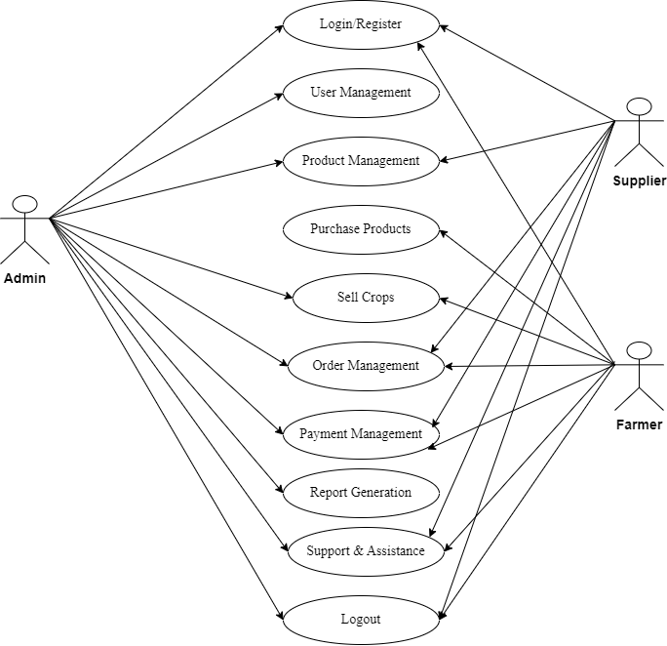
3.1 Use Case Diagram:
(1) Admin
(2) Supplier
(3) Farmer:

Slide 55
3.2. Data Dictionary:
List of all the table in database:
Database Name: dbams
Admin
Supplier
Farmer
Product
Order
Order_Details
Payment
Crop
Land
Warehouse
11.Inventory
12.Transport
13.Supplier_Order
14.Support
15.Weather
16.Equipment
17.Insurance
18.Training
19.Notification
20.Review

Slide 56
1)Admin Table
Column Name | Data Type | Constraints | Description | Example Value
admin_id | INT (5) | PRIMARY KEY | Unique identifier for each admin | 1
username | VARCHAR (20) | NOT NULL, UNIQUE | Admin's username | admin_user
password | VARCHAR (10) | NOT NULL | Admin's password | password123
email | VARCHAR (20) | NOT NULL, UNIQUE | Admin's email address | admin@example.com
created_at | DATETIME | DEFAULT CURRENT_TIMESTAMP | Timestamp of account creation | 2023-01-01 10:00:00
last_login | DATETIME |  | Timestamp of last login | 2023-10-01 12:00:00

Slide 57
2) Supplier Table
Column Name | Data Type | Constraints | Description | Example Value
supplier_id | INT (5) | PRIMARY KEY | Unique identifier for each supplier | 1
name | VARCHAR (20) | NOT NULL | Supplier's name | Green Farms
contact_number | VARCHAR (15) | NOT NULL | Supplier's contact number | +1234567890
email | VARCHAR (20) | NOT NULL, UNIQUE | Supplier's email address | supplier@example.com
address | VARCHAR (50) |  | Supplier's address | 123 Farm Lane, Agriculture City
created_at | DATETIME | DEFAULT CURRENT_TIMESTAMP | Timestamp of supplier registration | 2023-01-05 09:00:00

Slide 58
3) Farmer Table
Column Name | Data Type | Constraints | Description | Example Value
farmer_id | INT (5) | PRIMARY KEY | Unique identifier for each farmer | 1
name | VARCHA (20) | NOT NULL | Farmer's name | John Doe
contact_number | VARCHAR (10) | NOT NULL | Farmer's contact number | +0987654321
email | VARCHAR (20) | NOT NULL, UNIQUE | Farmer's email address | john.doe@example.com
farm_location | VARCHAR (20) |  | Location of the farm | 456 Crop Road, Farmville
created_at | DATETIME | DEFAULT CURRENT_TIMESTAMP | Timestamp of farmer registration | 2023-01-10 08:30:00

Slide 59
4)Product Table
Column Name | Data Type | Constraints | Description | Example Value
product_id | INT (5) | PRIMARY KEY | Unique identifier for each product | 1
name | VARCHAR (20) | NOT NULL | Name of the product | Organic Fertilizer
type | VARCHAR (10) | NOT NULL | Type of product (e.g., fertilizer) | Fertilizer
supplier_id | INT (5) | FOREIGN KEY (supplier_id) | Reference to the supplier | 1
price | DECIMAL (10,2) | NOT NULL | Price of the product | 25.00
created_at | DATETIME | DEFAULT CURRENT_TIMESTAMP | Timestamp of product entry | 2023-01-15 11:00:00

Slide 60
5)Order Table
Column Name | Data Type | Constraints | Description | Example Value
order_id`` | INT (5) | PRIMARY KEY | Unique identifier for each order | 1
farmer_id | INT (5) | FOREIGN KEY (farmer_id) | Reference to the farmer | 1
order_date | DATETIME | NOT NULL | Date when the order was placed | 2023-01-25 10:00:00
total_amount | DECIMAL (10,2) | NOT NULL | Total amount for the order | 150.00
status | VARCHAR (20) | NOT NULL | Current status of the order | Pending

Slide 61
6)Order Details Table
Column Name | Data Type | Constraints | Description | Example Value
order_detail_id | INT (5) | PRIMARY KEY | Unique identifier for each order detail | 1
order_id | INT (5) | FOREIGN KEY (order_id) | Reference to the order | 1
product_id | INT (5) | FOREIGN KEY (product_id) | Reference to the product | 1
quantity | INT (5) | NOT NULL | Quantity of the product ordered | 5
price | DECIMAL(10,2) | NOT NULL | Price of the product at the time of order | 25.00

Slide 62
7)Payment Table
Column Name | Data Type | Constraints | Description | Example Value
payment_id | INT (5) | PRIMARY KEY | Unique identifier for each payment | 1
order_id | INT (5) | FOREIGN KEY (order_id) | Reference to the order | 1
payment_date | DATETIME | NOT NULL | Date when the payment was made | 2023-01-26 09:00:00
amount | DECIMAL (10,2) | NOT NULL | Amount paid | 150.00
payment_method | VARCHAR (50) | NOT NULL | Method of payment (e.g., credit card) | Credit Card

Slide 63
8)Crop Table
Column Name | Data Type | Constraints | Description | Example Value
crop_id | INT (5) | PRIMARY KEY | Unique identifier for each crop | 1
name | VARCHAR (20) | NOT NULL | Name of the crop | Wheat
type | VARCHAR (50) | NOT NULL | Type of crop (e.g., cereal) | Cereal
season | VARCHAR (50) | NOT NULL | Season when the crop is grown | Spring
created_at | DATETIME | DEFAULT CURRENT_TIMESTAMP | Timestamp of crop entry | 2023-02-01 10:00:00

Slide 64
9)Land Table
Column Name | Data Type | Constraints | Description | Example Value
land_id | INT (5) | PRIMARY KEY | Unique identifier for each land | 1
farmer_id | INT (5) | FOREIGN KEY (farmer_id) | Reference to the farmer | 1
size | DECIMAL (10,2) | NOT NULL | Size of the land in acres | 10.50
location | VARCHAR (20) | NOT NULL | Location of the land | 789 Farm Road, Agriculture City
created_at | DATETIME | DEFAULT CURRENT_TIMESTAMP | Timestamp of land entry | 2023-02-05 08:30:00

Slide 65
10)Warehouse Table
Column Name | Data Type | Constraints | Description | Example Value
warehouse_id | INT (5) | PRIMARY KEY | Unique identifier for each warehouse | 1
location | VARCHAR (20) | NOT NULL | Location of the warehouse | 123 Storage Lane, Farmville
capacity | INT (10) | NOT NULL | Maximum capacity of the warehouse | 1000
created_at | DATETIME | DEFAULT CURRENT_TIMESTAMP | Timestamp of warehouse entry | 2023-02-10 09:00:00

Slide 66
11)inventory Table
Column Name | Data Type | Constraints | Description | Example Value
inventory_id | INT (5) | PRIMARY KEY | Unique identifier for each inventory item | 1
product_id | INT (5) | FOREIGN KEY (product_id) | Reference to the product | 1
quantity | INT (5) | NOT NULL | Quantity of the product in stock | 200
warehouse_id | INT (5) | FOREIGN KEY (warehouse_id) | Reference to the warehouse | 1
created_at | DATETIME | DEFAULT CURRENT_TIMESTAMP | Timestamp of inventory entry | 2023- 02-15 10:00:00

Slide 67
12)Transport Table
Column Name | Data Type | Constraints | Description | Example Value
transport_id | INT (5) | PRIMARY KEY | Unique identifier for each transport | 1
vehicle_number | VARCHAR (20) | NOT NULL | Vehicle registration number | ABC1234
driver_name | VARCHAR (100) | NOT NULL | Name of the driver | Jane Smith
capacity | INT (5) | NOT NULL | Maximum capacity of the vehicle | 500
created_at | DATETIME | DEFAULT CURRENT_TIMESTAMP | Timestamp of transport entry | 2023-02-20 11:00:00

Slide 68
13)Supplier Order Table
Column Name | Data Type | Constraints | Description | Example Value
supplier_order_id | INT (5) | PRIMARY KEY | Unique identifier for each supplier order | 1
supplier_id | INT (5) | FOREIGN KEY (supplier_id) | Reference to the supplier | 1
order_date | DATETIME | NOT NULL | Date when the order was placed | 2023-02-25 10:00:00
total_amount | DECIMAL (10,2) | NOT NULL | Total amount for the supplier order | 300.00

Slide 69
14)Supplier Order Table
Column Name | Data Type | Constraints | Description | Example Value
support_id | INT (5) | PRIMARY KEY | Unique identifier for each support request | 1
farmer_id | INT (5) | FOREIGN KEY (farmer_id) | Reference to the farmer | 1
issue_description | TEXT | NOT NULL | Description of the issue | Crop disease reported
status | VARCHAR (50) | NOT NULL | Current status of the support request | Open
created_at | DATETIME | DEFAULT CURRENT_TIMESTAMP | Timestamp of support request entry | 2023-03-01 09:00:00

Slide 70
15)Weather Table
Column Name | Data Type | Constraints | Description | Example Value
weather_id | INT (5) | PRIMARY KEY | Unique identifier for each weather record | 1
date | DATE | NOT NULL | Date of the weather report | 2023-03-05
temperature | DECIMAL (5,2) | NOT NULL | Temperature in degrees Celsius | 25.50
humidity | DECIMAL (5,2) | NOT NULL | Humidity percentage | 60.00
rainfall | DECIMAL (5,2) |  | Amount of rainfall in mm | 10.00

Slide 71
16)Equipment Table
Column Name | Data Type | Constraints | Description | Example Value
equipment_id | INT (5) | PRIMARY KEY | Unique identifier for each equipment | 1
name | VARCHAR (20) | NOT NULL | Name of the equipment | Tractor
type | VARCHAR (10) | NOT NULL | Type of equipment (e.g., machinery) | Machinery
purchase_date | DATETIME | NOT NULL | Date when the equipment was purchased | 2023-03-10 10:00:00
status | VARCHAR (50) | NOT NULL | Current status of the equipment | Operational

Slide 72
17)Insurance Table
Column Name | Data Type | Constraints | Description | Example Value
insurance_id | INT (5) | PRIMARY KEY | Unique identifier for each insurance policy | 1
farmer_id | INT (5) | FOREIGN KEY (farmer_id) | Reference to the farmer | 1
policy_number | VARCHAR (10) | NOT NULL, UNIQUE | Insurance policy number | INS123456
coverage_amount | DECIMAL (10,2) | NOT NULL | Amount covered by the insurance | 10000.00
start_date | DATE | NOT NULL | Start date of the insurance policy | 2023-03 -01
end_date | DATE | NOT NULL | End date of the insurance policy | 2024-03-01

Slide 73
18)Traning Table
Column Name | Data Type | Constraints | Description | Example Value
training_id | INT (5) | PRIMARY KEY | Unique identifier for each training session | 1
topic | VARCHAR (100) | NOT NULL | Topic of the training session | Sustainable Farming Practices
date | DATE | NOT NULL | Date of the training session | 2023-03-15
duration | INT (5) | NOT NULL | Duration of the training in hours | 3
created_at | DATETIME | DEFAULT CURRENT_TIMESTAMP | Timestamp of training entry | 2023-03-01 12:00:00

Slide 74
19)Notification Table
Column Name | Data Type | Constraints | Description | Example Value
notification_id | INT (5) | PRIMARY KEY | Unique identifier for each notification | 1
farmer_id | INT (5) | FOREIGN KEY (farmer_id) | Reference to the farmer | 1
message | TEXT | NOT NULL | Notification message | New training session available
date_sent | DATETIME | NOT NULL | Date when the notification was sent | 2023-03-02 09:00:00

Slide 75
20)Review Table
Column Name | Data Type | Constraints | Description | Example Value
review_id | INT (5) | PRIMARY KEY | Unique identifier for each review | 1
farmer_id | INT (5) | FOREIGN KEY (farmer_id) | Reference to the farmer | 1
rating | INT (5) | NOT NULL | Rating given by the farmer (1-5) | 5
comments | TEXT |  | Comments provided by the farmer | Excellent service and support
created_at | DATETIME | DEFAULT CURRENT_TIMESTAMP | Timestamp of review entry | 2023-03-03 10:00:00

Slide 76
4. Devlopment
3.2. Data Dictionary:
4.1. Coding Standards:
4.1.1.PSP Standards: Follow PHP-FIG's PSR (PHP Standards Recommendations), especially:
PSR-1: Basic coding standard.
PSR-2: Coding style guide.
PSR-4: Autoloading standard.
4.1.2. Naming Conventions:
Use CamelCase for class names (e.g., User Model).
Use snake_case for method and variable names (e.g.,get_user_data).
Use descriptive names for variables and functions.

Slide 77
4.1.3. File Structure:
Organize files in a logical directory structure (e.g., controllers, models, views).
Keep configuration files separate and organized.
4.1.4. Comments and Documentation:
Use comments to explain complex logic.
Utilize PHPDoc for documenting classes and methods.
4.1.5. Error Handling:
Implement proper error handling using try-catch blocks.
Use logging for errors instead of displaying them to users.
4.1.6. Security Practices:
Sanitize and validate user inputs to prevent SQL injection and XSS.
Use CodeIgniter's built-in functions for escaping output.

Slide 78
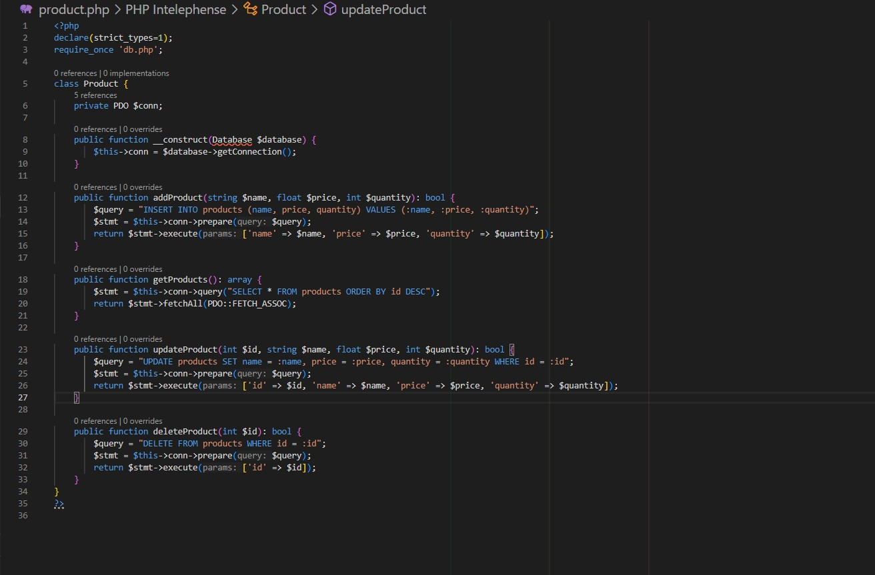
Code Example:
1)Product.php

Slide 79
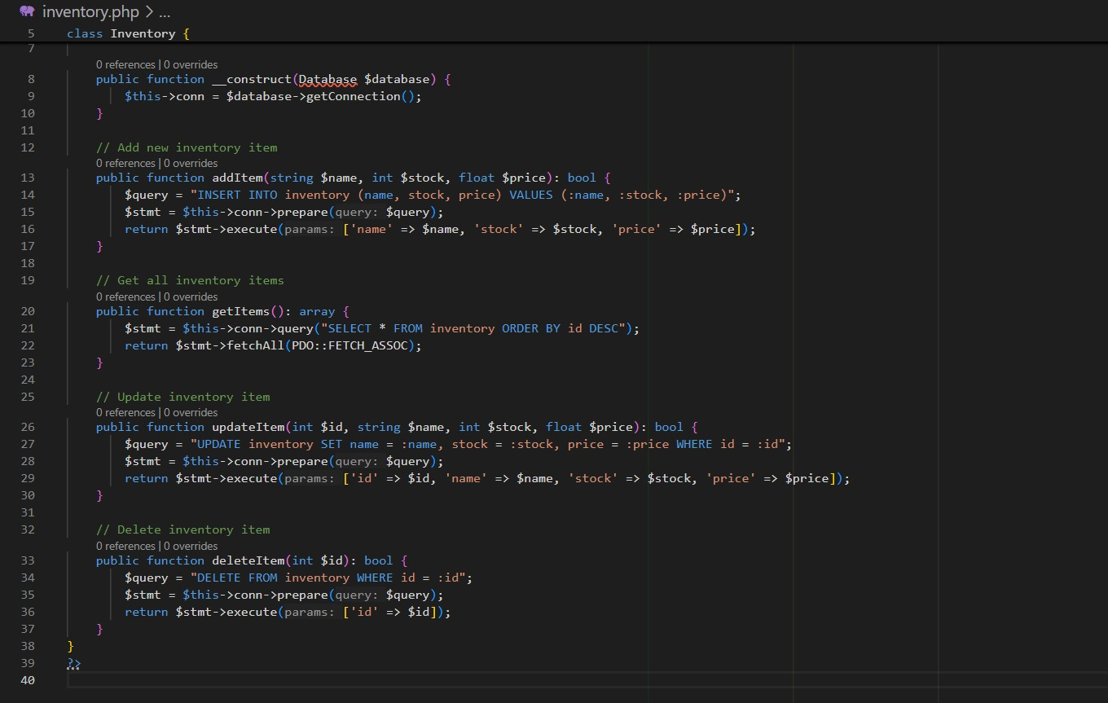
2)Inventory.php

Slide 80
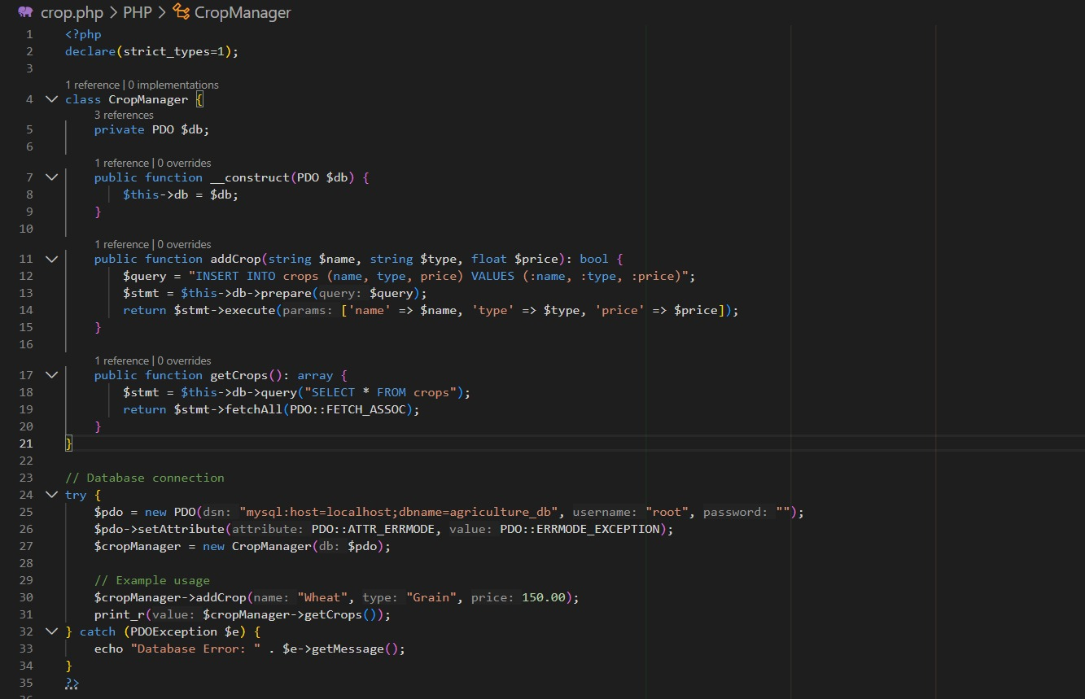
3)crop.php

Slide 81
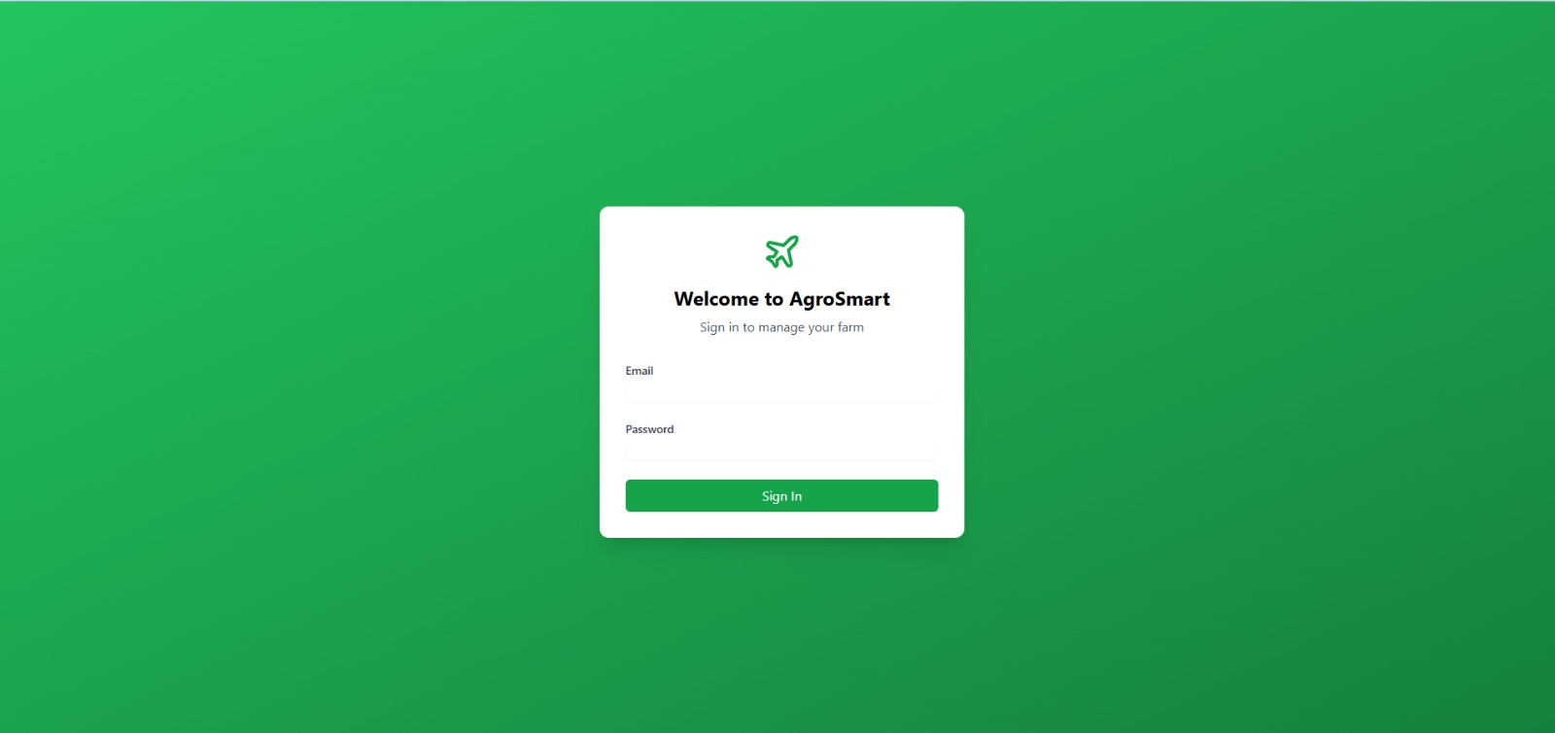
.2. Screen Shots:
1)Login page:A simple login form requiring an email and password with options for account creation.

Slide 82
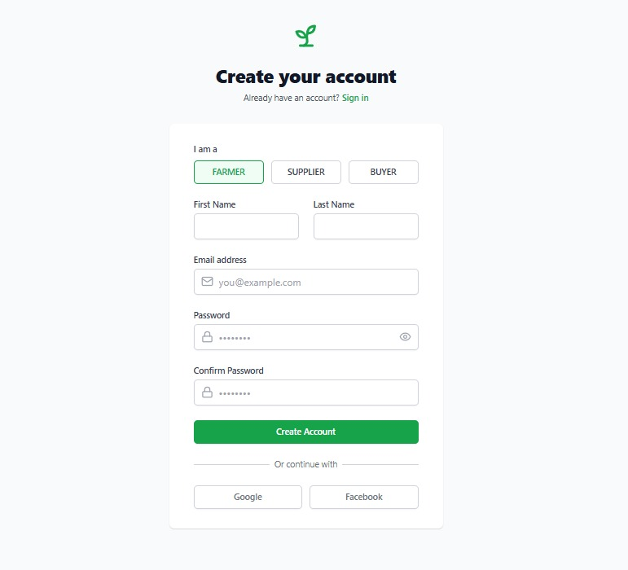
2)Register Page:

Slide 83
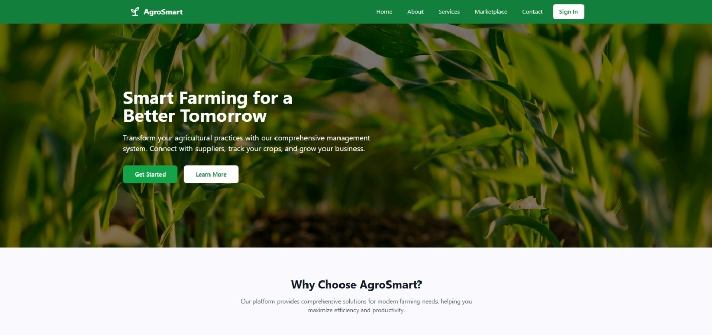
3)Home Page:

Slide 84
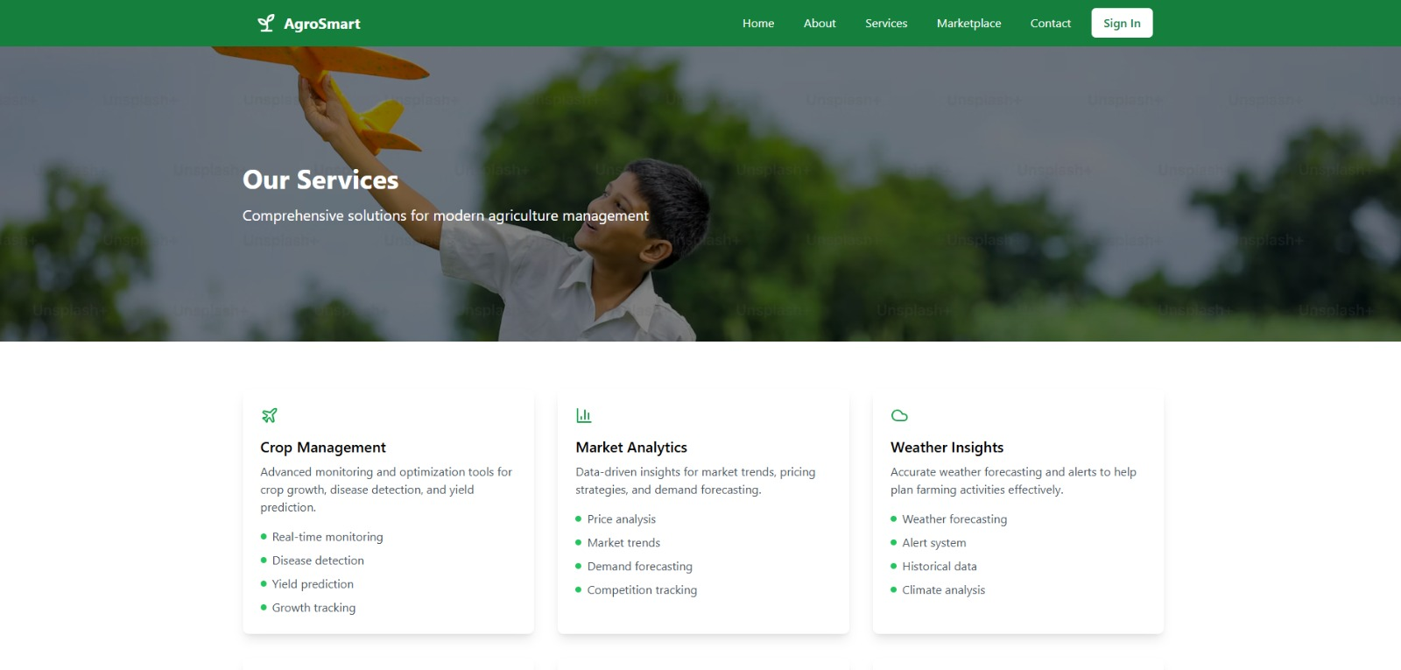
4)Over Service:

Slide 85
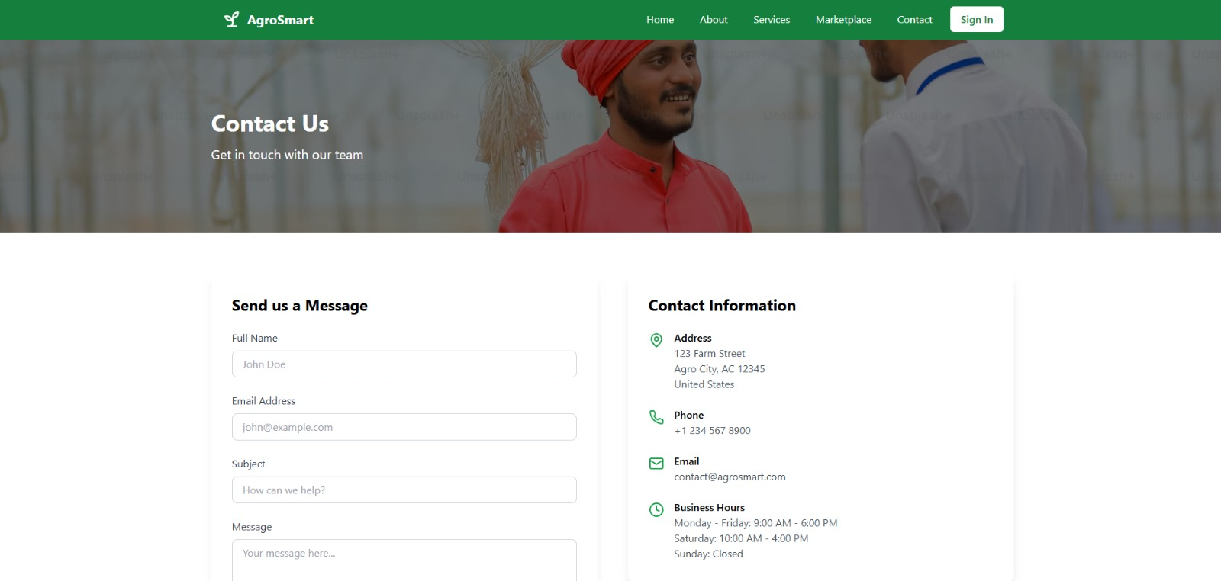
5)Contact Us:

Slide 86
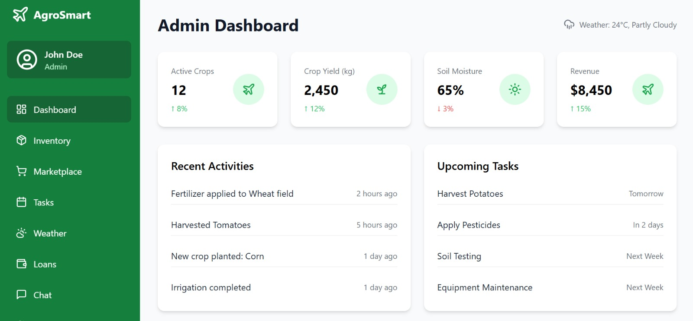
6)Admin Dashboard:

Slide 87
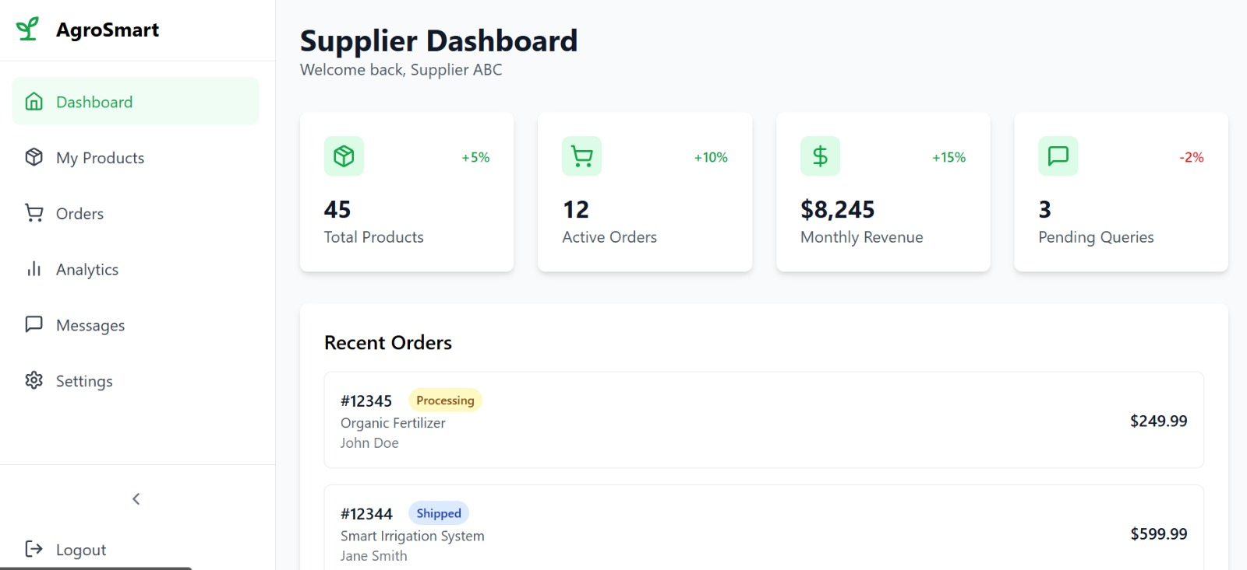
7)Supplier Dashboard:

Slide 88
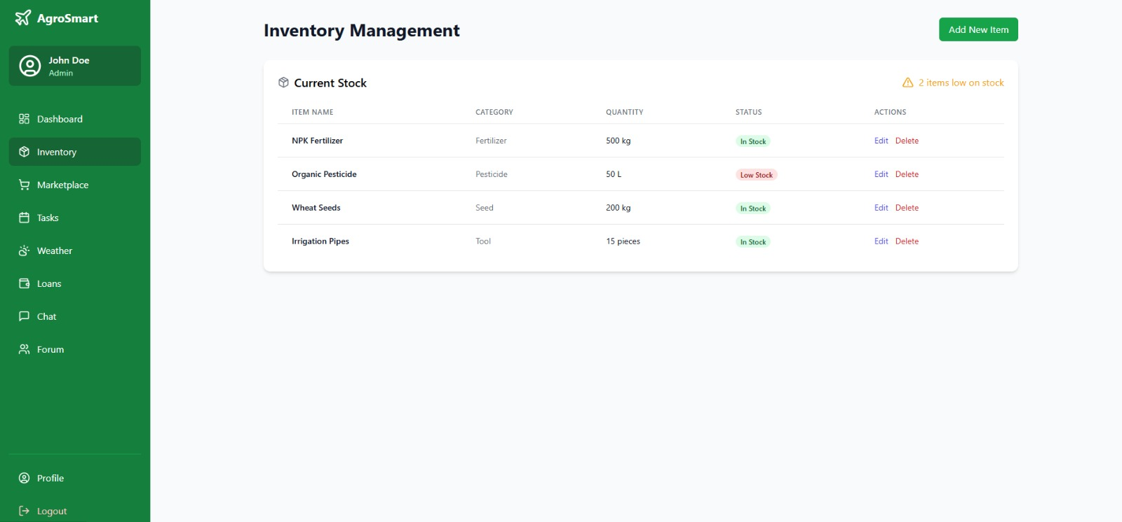
8)Inventory Management:

Slide 89
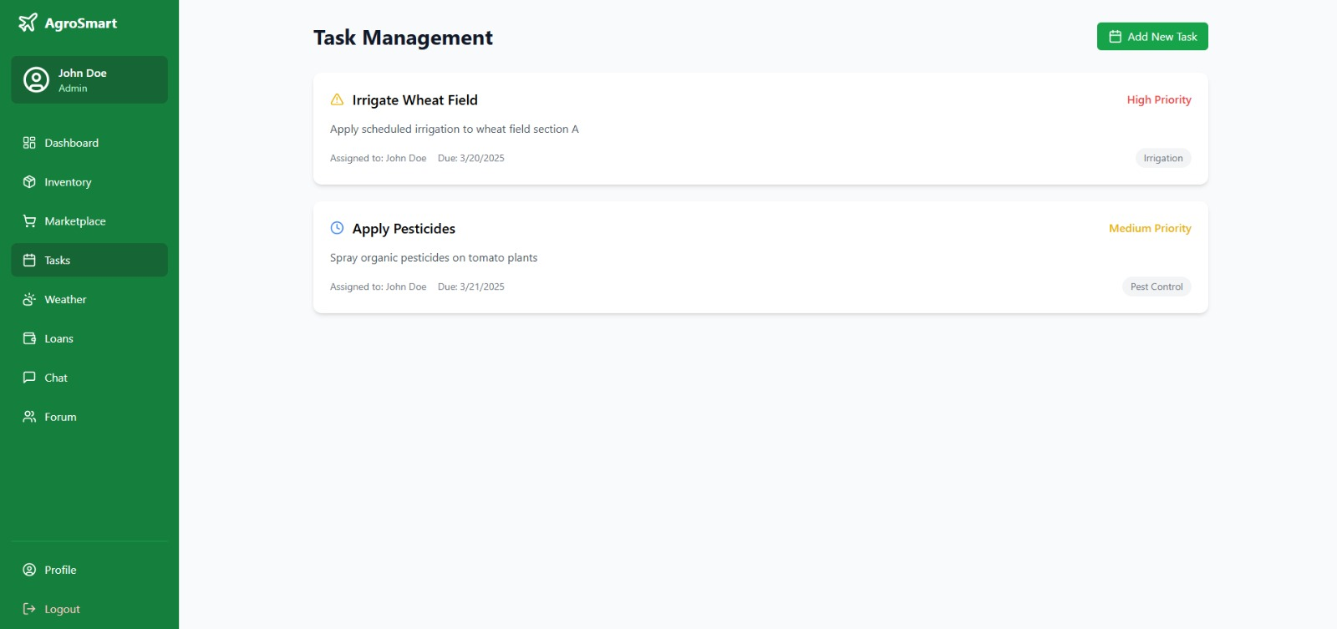
9)Task Management:

Slide 90
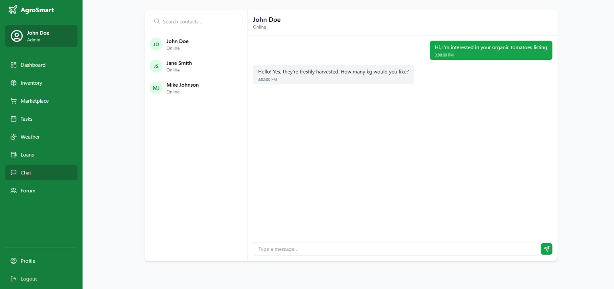
10)Chate Page:

Slide 91
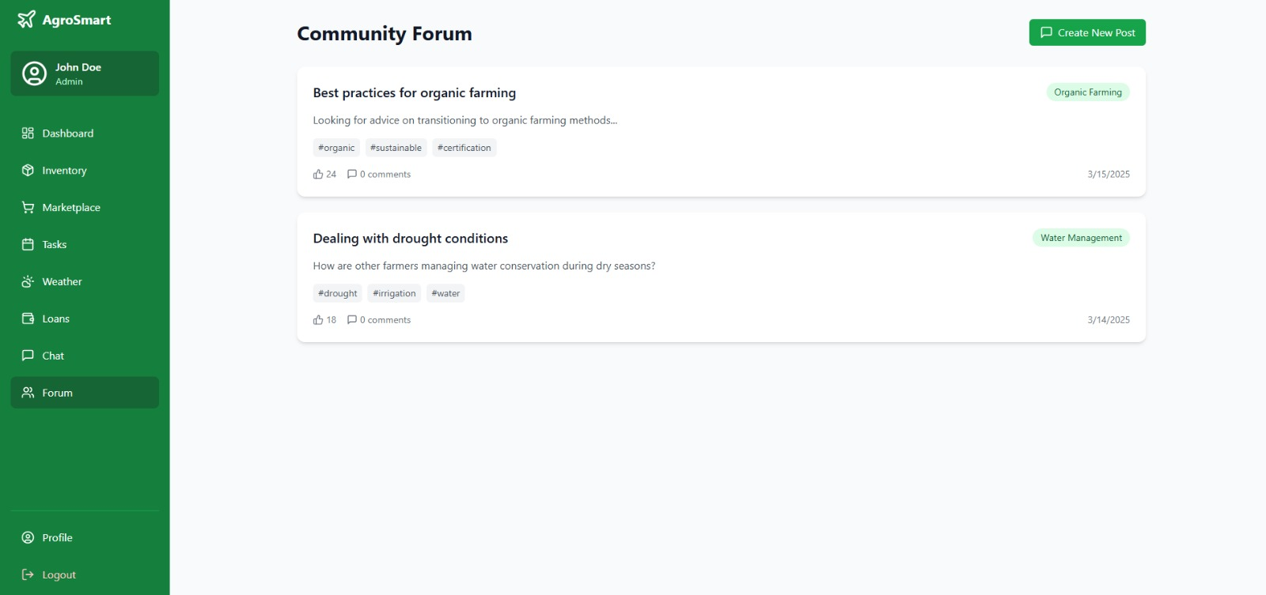
11)Community forum:

Slide 92
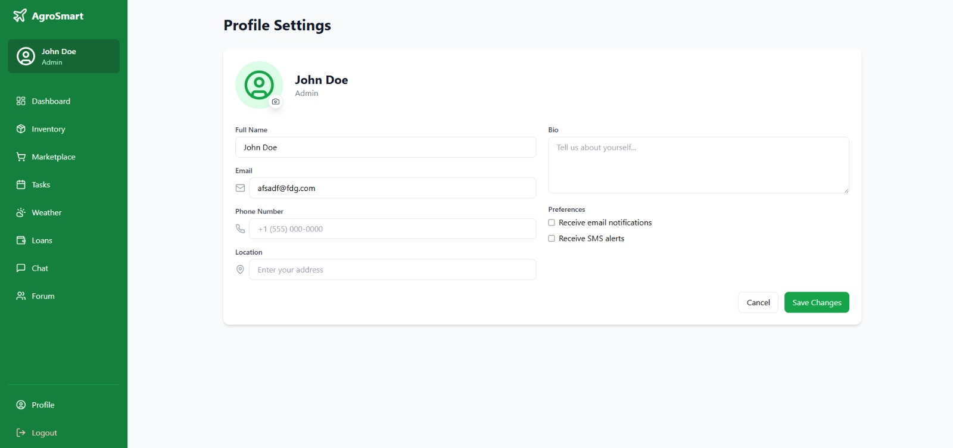
12)Profile Setting:

Slide 93
5. Agile Document
Agile Project Charter
Project Name: | Campus Recruitment System
Project Champion: | Ankit Khavadiya
Project Sponsor: | Amit Chudesara
Project Manager: | Simun Saiyed
Expected Start Date: | 1 Jan 2025
Expected Completion Date: | 20 march 2025
Project Goal: | The goal of an Agriculture Management System is to enhance efficiency, productivity, and sustainability in farming operations by leveraging technology. The system aims to help farmers, agribusinesses, and stakeholders manage resources effectively, monitor crop and livestock conditions, and make data-driven decisions.
Project Vision: | The vision of the Agriculture Management System is to revolutionize the agricultural sector by integrating smart technology, automation, and data-driven insights to enhance productivity, sustainability, and profitability for farmers and agribusinesses.
Project Scope: | The scope of the Agriculture Management System defines its features, functionalities, and limitations. This system aims to provide a comprehensive solution for farmers, agribusinesses, and stakeholders to efficiently manage agricultural activities.
Key Stakeholders: | The Admin oversees system management, user access, and overall platform maintenance. The Farmer utilizes the system for crop planning, resource management, and market access, while the Supplier provides essential farming inputs like seeds, fertilizers, and equipment, ensuring a smooth supply chain.

Slide 94
Agile Roadmap / Schedule:
Agile Roadmap/Schedule for Agriculture Management System(AMS)
 | Duration | Theme/Epic | Features
Phase 1: Planning & Design | Week 1 | Requirement Gathering & System Planning | Define scope, gather requirements, finalize tech stack, design database schema, UI/UX wireframes.
 | Week 2 | System Architecture & UI/UX Design | Design database schema, UI/UX wireframes, and set up development environment.
Phase 2: Core Development | Week 3 | Admin Module | Admin dashboard, user role management, system configuration, reports, and security settings.
 | Week 4 | Farmer Module | Farmer registration, profile management, and Buy Product and Sell crop.
 | Week 5 | Supplier | Supplier registration, Product sell and buy crop.
 | Week 6 | Placement Staff Module | Placement cell dashboard, job approvals, student tracking, analytics.
Phase 3: Testing & Refinement | Week 7 | System Testing & Refinement | Unit testing for Admin, Farmer, and Supplier modules.
 | Week 8 | Integration Testing & Compliance Review | Integration testing, data security validation, role-based access verification.
Phase 4: Deployment & UAT | Week 9 | User Acceptance Testing (UAT) | User Acceptance Testing (UAT), collect feedback, fix bugs, optimize performance.
Phase 5: Final Deployment & Support | Week 10 | Go-Live & Post-Deployment Support | Full system deployment, real-time monitoring, and ongoing maintenance.
. Agile Roadmap / Schedule:

Slide 95
5.3. Agile Project Plan:
AGILE PROJECT PLAN TEMPLATE
Campus Recruitment System |  |  |  |  | START DATE | END DATE | OVERALL PROGRESS
Simun Saiyed |  |  |  |  | ! Jan 2025
TASK NAME | RESPONSIBLE | STORY POINTS | START | FINISH | DURATION in days | STATUS | COMMENTS
SPRINT 1 |  |  | 01-Jan-25 | 19‐Jan‐25 | 19 | Completed
Gather Information | All | 0 | 01-Jan-25 | 4-Jan-25 | 4 | Completed | Initial data gathering
Identify Stackholders | All | 0 | 5-Jan-25 | 7-Jan-25 | 3 | Completed | Identifying users & role
Define System Architecture | All | 0 | 8-Jan-25 | 11-Jan-25 | 4 | Completed | Defining architecture for scalability
Design Database Schema | All | 0 | 12-Jan-25 | 15-Jan-25 | 4 | Completed | Designing database relations
Create UI/UX | All | 0 | 16-Jan-25 | 19-Jan-25 | 4 | Completed | Creating UI mockups
SPRINT 2 |  |  | 20-Jan-25 | 06-Feb-25 | 17 | Completed | Admin
Develop Admin Dashboard | Ankit khavadiya | 1 | 20-Jan-25 | 22-Jan-25 | 3 | Completed | Counted data
Supplier Management | Amit Chudesara | 3 | 23-Jan-25 | 26-Jan-25 | 4 | Completed | Add, Approve/Reject
Student Management | Saiyed Simun | 3 | 27-Jan-25 | 30-Jan-25 | 4 | Completed | Add/Delete
Farmer Management | Ankit Khavadiya | 1 | 01-Feb-25 | 03-Feb-25 | 3 | Completed | Add/View
Approve/Reject Job | Amit Chudesara | 2 | 04-Feb-25 | 06-Feb-25 | 3 | Completed | Add/View/Delete

Slide 96
 | SPRINT 3 |  |  | 07-Feb-25 | 22-Feb-25 | 16 | Completed | Supplier
No | Profile Management | Ankit Khavadiya | 1 | 07-Feb-25 | 09-Feb-25 | 3 | Completed | Counted data
Yes | Product management | Amit Chudesara | 3 | 10-Feb-25 | 12-Feb-25 | 3 | Completed | Add/Delete/Edit
Yes | Order Management | Simun Saiyed | 4 | 13-Feb-25 | 15- Feb -25 | 3 | Completed | Date/ time , location
Yes | Analytics | Ankit Khavadiya | 2 | 16-Feb-25 | 18- Feb -25 | 3 | Completed | Round wise
Yes | Massages | Amit Chudesara | 2 | 19-Feb-25 | 20- Feb -25 | 2 | Completed | Excel file
No | Revenue | Simun Saiyed | 1 | 21-Feb-25 | 22-Feb-25 | 2 | Completed | status
 | SPRINT 4 |  |  | 23-Feb-25 | 12-Mar-25 | 19 | Completed | Farmer
Yes | Farmer Login/Register/Home Page | Amit Chudesara , Ankit Khavadiya | 4 | 23-Feb-25 | 26-Feb-25 | 5 | Completed
Yes | View Product | Simun Saiyed | 5 | 27-Feb-25 | 1-Mar-25 | 3 | Completed | Role/company
yes | Add to cart | Ankit Khavadiya | 5 | 02-Mar-25 | 04-Mar-25 | 3 | Completed | Round wise
No | Apply For Supplier | Saiyed Simun | 1 | 05-Mar-25 | 06-Mar-25 | 2 | Completed | Schedule interview
yes | View Notification | Amit Chudesara | 2 | 07-Mar-25 | 09-Mar-25 | 3 | Completed | About job/interview
No | About us/Feedback | Ankit Khavadiya | 0 | 10-Mar-25 | 12-Mar-25 | 3 | Pending | Feedback/review

Slide 97
5.4. Agile User Story (Minimum 3 Tasks):
User Story ID | Priority | As a (User Type) | I want to (Task) | So that I can (Goal)
1 | High | Farmer | Register and log in to the system | Access my farm data securely
2 | High | Admin | Manage user roles and permissions | Ensure secure and appropriate access to the system
3 | Medium | Supplier | Register my business | Offer agricultural products to farmers
4 | High | Farmer | Add and update farm details | Keep track of my farm’s crops and soil conditions
5 | High | Farmer | Receive weather updates | Plan my farming activities effectively
6 | Medium | Supplier | Manage inventory of seeds and fertilizers | Keep track of available stock
7 | High | Admin | View reports and analytics | Monitor system usage and farm productivity
8 | Medium | Farmer | Schedule irrigation reminders | Ensure proper watering for my crops

Slide 98
9 | High | Supplier | Process and track orders | Deliver farming supplies efficiently
10 | High | Farmer | Request farming equipment | Easily access necessary tools for farming
11 | Medium | Admin | Approve or reject supplier registrations | Maintain system integrity and reliability
12 | Medium | Farmer | Track expenses and sales | Manage my farm’s financial performance
13 | High | Farmer | Receive pest and disease alerts | Take preventive actions to protect crops
14 | High | Admin | Generate system-wide reports | Analyze performance and usage trends
15 | Medium | Farmer | Communicate with suppliers and other farmers | Exchange knowledge and make informed decisions

